Slide 1

Real Estate Finance FINM 3406 Week 4 – Tutorial 3
Prepared by : Rasheda Huda

Slide 2
Activity One - Real Estate Ownership Structures (REITs)
One of the most recent REITs to be listed on the Australian Stock Exchange (ASX) is RAM Essential Services Property Fund (ASX:REP). This REIT was listed on the ASX on 20 October 2021.
Attached (in BB) is the presentation for REP’s half yearly report (ending December 2022) and the Product Disclosure Statement released by REP prior to its listing on the ASX.

Slide 3
Have a look through these documents and then attempt to answer the following questions (note you will probably need to do a little bit of searching to find some of the answers):
(Please get into groups of 4 and discuss -10 mins)
1.What is the current market cap of RAM Essential Services Property Fund (REP)?
$398.62M (See: REP share price and company information for ASX:REP)

Slide 4
2. How much does it cost to buy one unit/share in REP?
$0.755
3. How many units/shares in REP on issue?
521,084,094

Slide 5
4. Is REP a stapled or externally managed fund?
Stapled
5.What property sectors does the fund invest in?
Essential retail (54.3% of portfolio by value)
Healthcare sector (45.7% of portfolio by value)

Slide 6
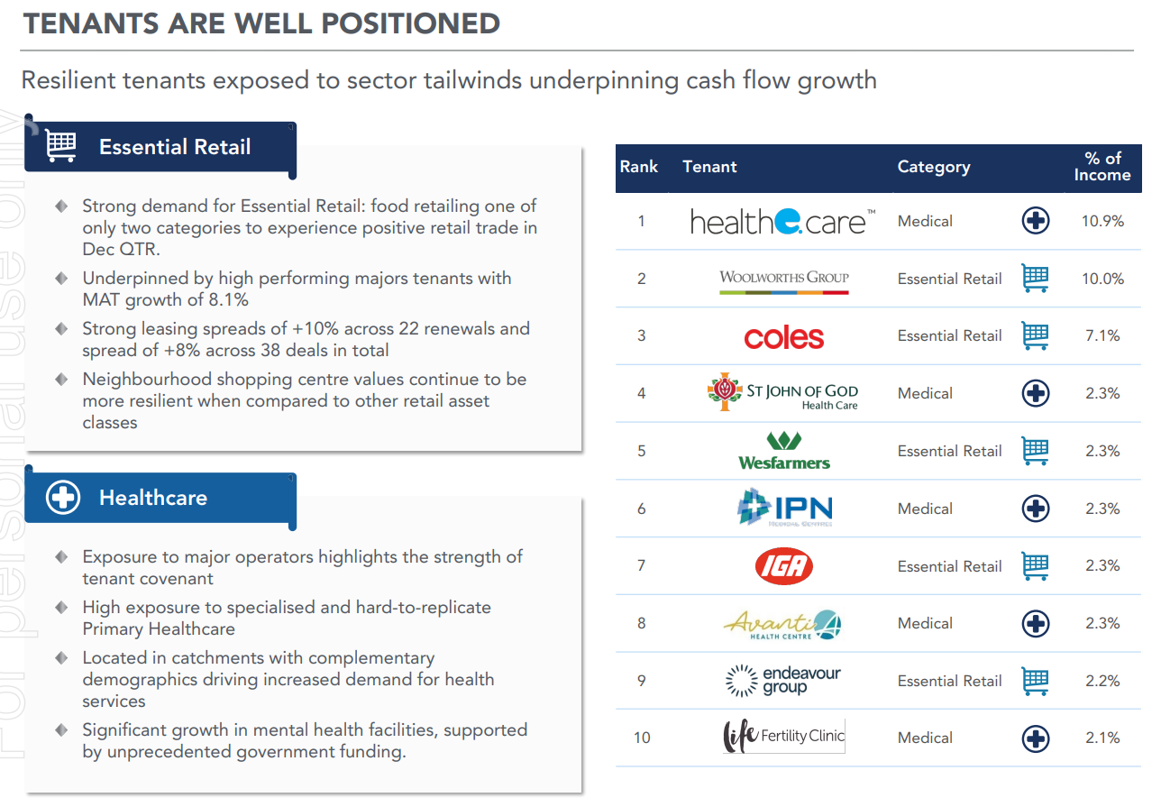

Slide 7
6. What is the total combined market value of the properties that REP fund owns?
$807.1M

Slide 8
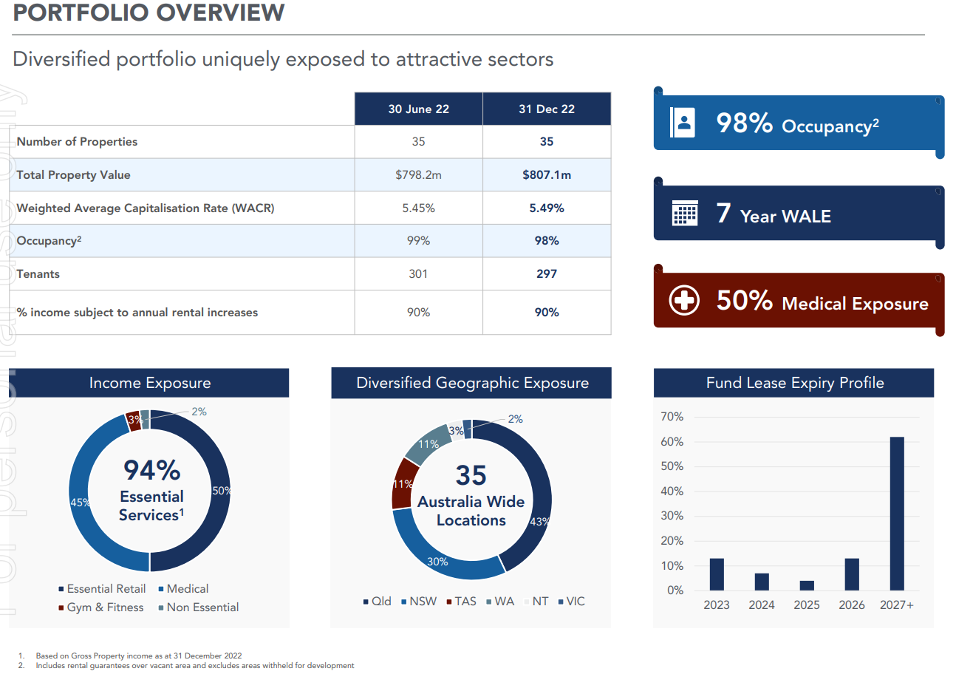

Slide 9
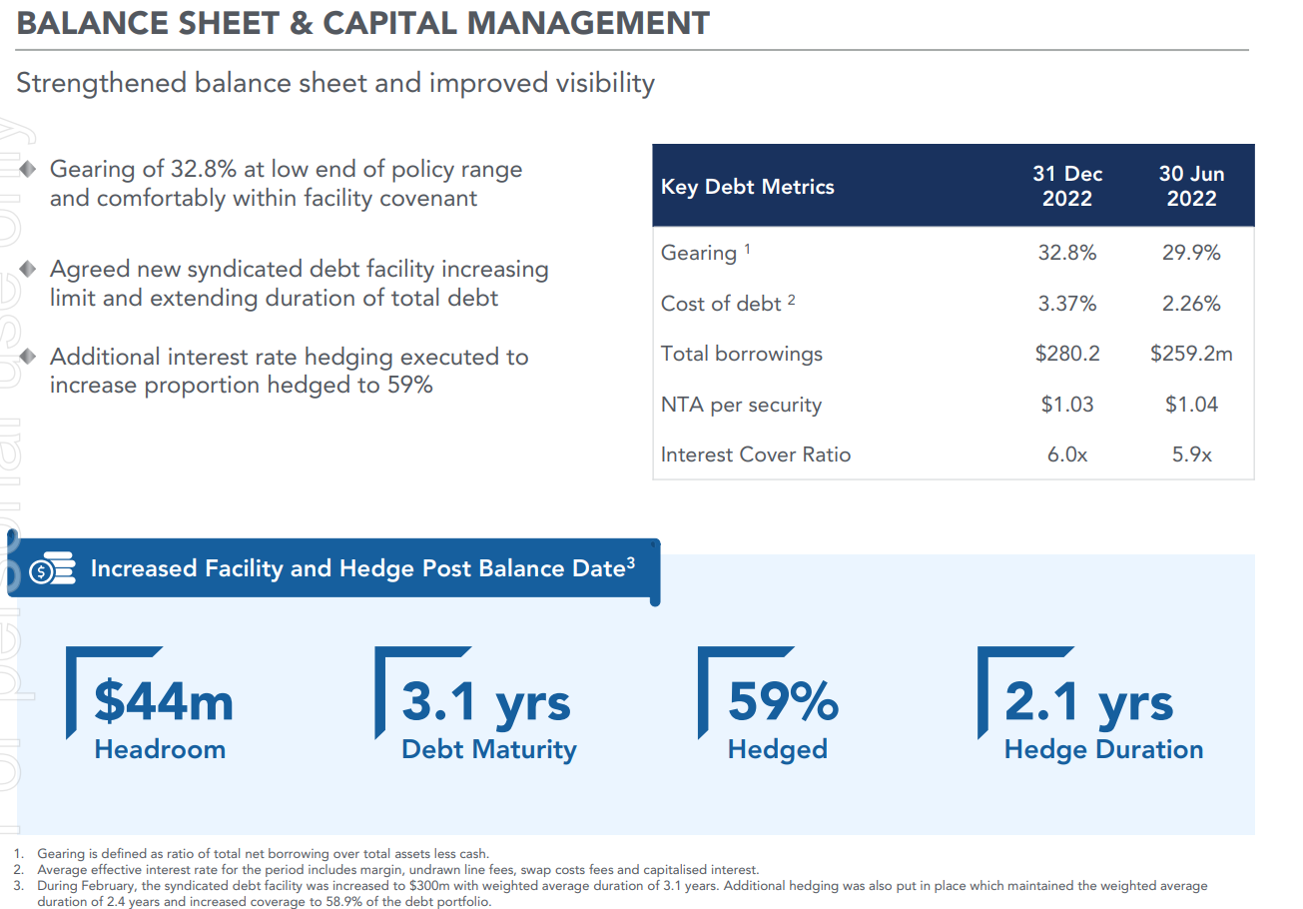
7. How much debt does REP have?
$280.2M
32.8% gearing

Slide 10
8.Is REP’s market cap greater or less than REP’s net asset position?
Market cap is less than net asset position.
Market Cap: $398.62M
Value of assets: $807.1M
Total debt: $280.2M
Net asset: $526.9M

Slide 11
9. What are your general observations about REP as a form of property investment?
No right or wrong answer.
Why is the market cap less than the value of the assets?
What has the price per share/unit performance looked like over the last year (ie high of $0.98 and low of $0.66)?
How liquid is the investment (daily average trading volume of 267,884)?

Slide 12
Are the property yields acceptable based upon risk profile/gearing
weighted average capitalisation rate of 5.49%
interest rates are rising and the av cost of debt was 3.37% up from 2.26%
gearing is at 32.8% up from 29.9%
What does the forecast dividend per unit look like? (forecast distribution of 5.7-5.8c per security – at 75.5c purchase price per unit this is a yield of about 7.6%)
Any comments about management fees? Do they seem high as a percentage of overall revenue?

Slide 13
Activity Two - Real Estate as an Asset Class
Read the attached recent article in news.com.au (link below) about a dispute between two property owners in Sydney and attempt the following questions.
Sydney apartment owners in Rose Bay in dispute over smoking on balcony | news.com.au — Australia’s leading news site

Slide 14
Note - You may get some ideas on how this problem could be resolved by looking at the law of private nuisance.
Details on the tort of private nuisance is not assessable content for this course but you might find reading about it interesting and give you more context about issues associated with owning and using real estate -
Private and Public Nuisance Tort Law Lecture (lawteacher.net)

Slide 15
1. In your opinion (without thinking about property rights, just your gut feeling), who do you think is in the right and who is in the wrong? Why?
Why shouldn’t the owner of the unit be allowed to smoke, it is her property?
Why shouldn’t the owner of the unit above be allowed to live without the fear of getting sick from passive smoking, it is his property?
Is there an ethical or moral consideration (ie “love thy neighbour”)?

Slide 16
Is there an economic consideration (ie the costs of smoking elsewhere compared to the costs of the upset unit owner moving elsewhere)?
Is it just a meaningless dispute between two angry people or does it have broader implications to the community (in fact it is a bit of both – if this goes to court it could set a precent on how a dispute like this is handled in the future)?

Slide 17
2.How would you think about this dispute in relation to concept of property as a "bundle of rights" and does that change your thinking about who is right and who is wrong?
This is an example of two people’s property rights coming into contact and clashing. The question is solved by deciding whose rights should prevail. Things to consider:

Slide 18
Points to ponder:
The bundle of rights that you have when you own property includes the right to use and enjoy your property.
you should have the right to do anything on your property that is not illegal.
the phrase “a person’s home is their castle” is meant to suggest inside your home you are the King or Queen and you can do as you please provided you aren’t breaking the law.
Smoking is not illegal generally but is not allowed by society in certain public locations (ie can’t smoke in pubs, clubs and restaurants anymore).

Slide 19
Accordingly you should be able to smoke in your own home (as an curious piece of trivia up until about 10 years ago in Queensland underage drinking at home was not illegal).
Units and apartments are slightly different to other freehold property such as a house and land in that they have a Body Corporate structure which owns the common property and sets rules that apply to ownership of units in the building.

Slide 20
Historic attempts to make rules to ban smoking on private balconies by Body Corporates have been thrown out by the courts (as smoking is not illegal and its was seen as an over reach by the Body Corporate in taking away rights of the owner, it has always been ok for the Body Corporates to ban smoking in common areas).
However a few recent decisions by courts are changing this approach (this is not yet settled law and will probably require legislation to sort out what can and can’t be banned).

Slide 21
Regardless of what the Body Corporate rules say the upset unit owner in this dispute has the right to bring action against the smoker in tort (ie a civil wrong) for private nuisance.
In other words if the smoke is continual and an unreasonable impact upon his enjoyment of his property rights then he may have the remedy of being paid compensation or getting a court order to make the smoking stop (or both).

Slide 22
3. What does a dispute like this mean for real estate in general as an investment asset class?
This dispute highlights some of the complexity that real estate as asset class has compared to other asset classes.
Things to ponder:
You may need to go to court to enforce your rights – expensive and inconvenient
Shows the importance of actively managing your asset to protect your rights (ie if you don’t complain about a “nuisance” and put up with it for too long the courts won’t help you stop it)

Slide 23
If you rent a property to someone what they do on the property may be legal but it may still create nuisance that could see them having to stop/leave the property (which could impact the certainty of your future rent)

